Slide 1
Selenium Workspace Setup
Java: To work with selenium Java is required, so download and install the Java JDK in your system, one must be aware of how to Download and Install Java for the 64-bit machine?
Eclipse IDE: Install the Eclipse IDE by referring to this article Eclipse IDE for Java Developers
Chrome Driver: Download the Google Chrome browser.

Slide 2
Navigate to the Maven central repository and select the updated version of the Selenium Webdriver version
https://mvnrepository.com/artifact/org.seleniumhq.selenium/selenium-java

Slide 3
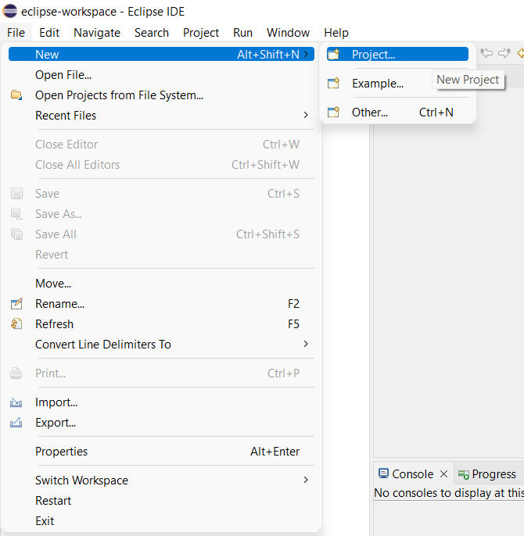
Step By Step Implementation:
Step 1: Create a New Maven Project
1.1: From the File menu, choose New, and then choose Project.

Slide 4
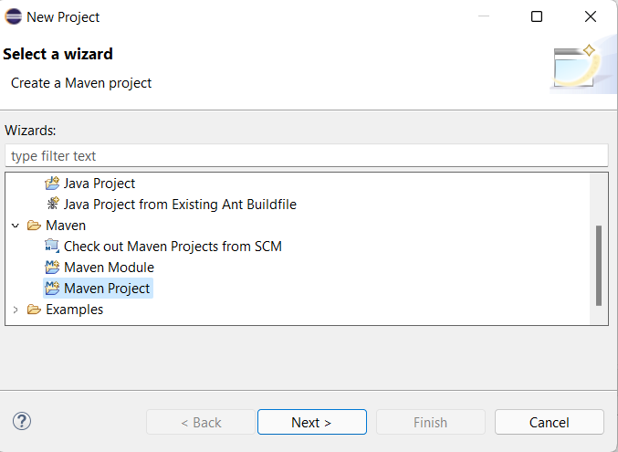
1.2: In the New Project window, choose Maven Project and click next

Slide 5
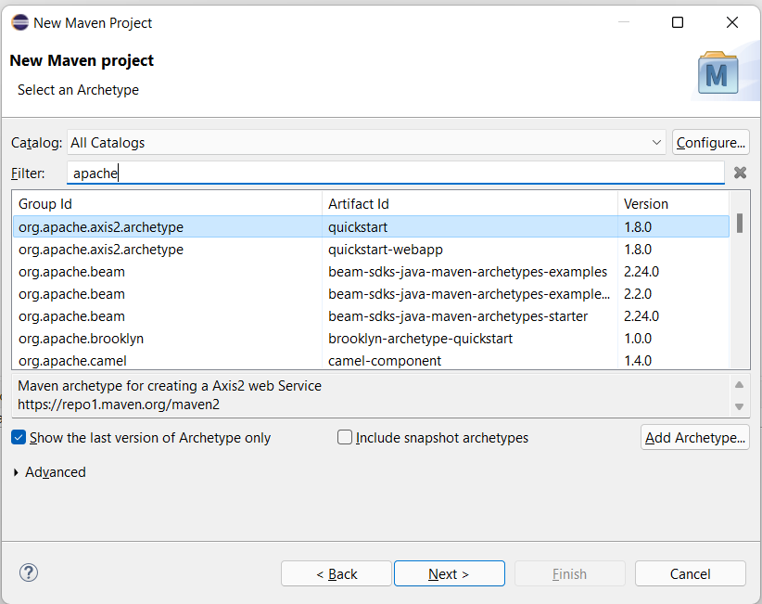
1.3: Select the archetype to “org.apache.axis2.archetype” quickstart by entering “apache” in Filter box and click next.

Slide 6
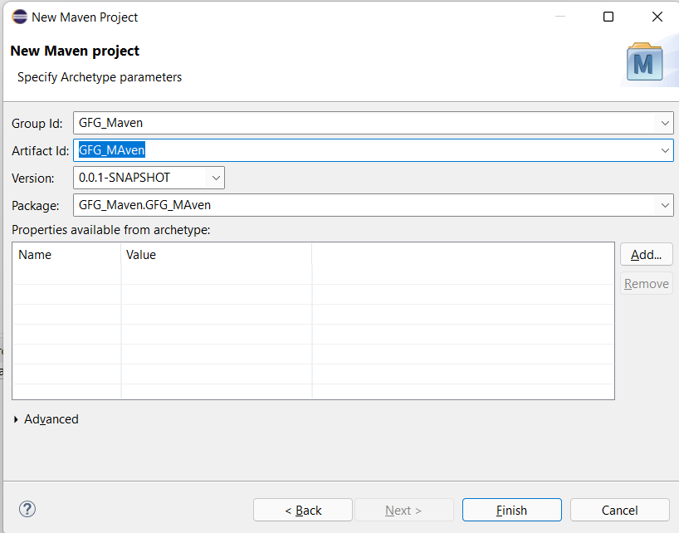
1.4: Enter the Group Id and Artifact Id and click on Finish.

Slide 7
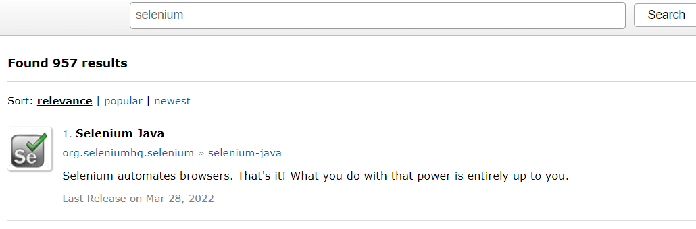
Step 2: Adding Dependency into the “pom.xml” file: 2.1: Go to Maven repository https://mvnrepository.com/ 2.2: Search for selenium in the repository and select the Selenium java

Slide 8
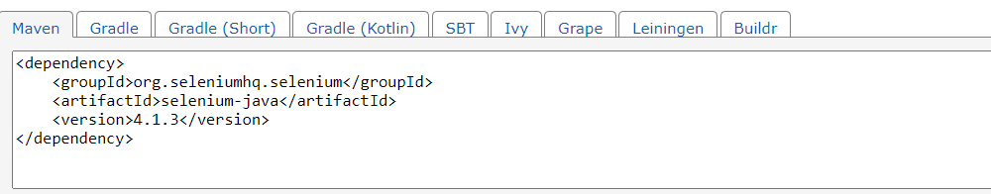
2.3: Select the latest version and copy the dependency

Slide 9
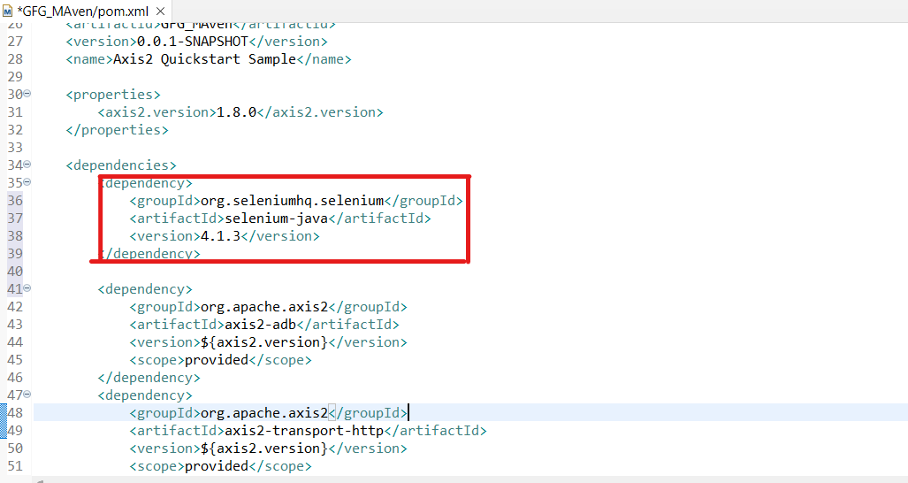
2.4: Paste the dependency into “pom.xml” under the dependencies file and save.

Slide 10
Step 3: Create Java Class File in the src folder
Step 4: Set a system property “webdriver.chrome.driver” to the path of your ChromeDriver.exe file and instantiate a ChromeDriver class:
System.setProperty("webdriver.chrome.driver","C:\\Users\\ADMIN\\Documents\\chromedriver.exe"); ChromeDriver driver = new ChromeDriver();

Slide 11
Open the pom.xml in the workspace root directory and paste the below Selenium Java version into the file
<dependencies> <dependency> <groupId>org.seleniumhq.selenium</groupId> <artifactId>selenium-java</artifactId> <version>4.9.0</version> </dependency> </dependencies>

Slide 12
Now the pom.xml file looks like below
<?xml version="1.0" encoding="UTF-8"?> <project xmlns="http://maven.apache.org/POM/4.0.0" xmlns:xsi="http://www.w3.org/2001/XMLSchema-instance" xsi:schemaLocation="http://maven.apache.org/POM/4.0.0 http://maven.apache.org/xsd/maven-4.0.0.xsd"> <modelVersion>4.0.0</modelVersion> <groupId>org.example</groupId> <artifactId>SeleniumJava</artifactId> <version>1.0-SNAPSHOT</version> <properties> <maven.compiler.source>8</maven.compiler.source> <maven.compiler.target>8</maven.compiler.target> <project.build.sourceEncoding>UTF-8</project.build.sourceEncoding> </properties> <dependencies> <dependency> <groupId>org.seleniumhq.selenium</groupId> <artifactId>selenium-java</artifactId> <version>4.9.0</version> </dependency> </dependencies> </project>

Slide 13
To Invoke Chrome Browser
package test; import org.openqa.selenium.WebDriver; import org.openqa.selenium.chrome.ChromeDriver; import org.openqa.selenium.chrome.ChromeOptions; public class SeleniumTest { public static void main(String[] args) { ChromeOptions options = new ChromeOptions();
// Set the path of the chromedriver, in our case it is placed in root folder System.setProperty("webdriver.chrome.driver", "chromedriver.exe"); WebDriver driver = new ChromeDriver(options); driver.get("https://gmail.com/"); driver.quit(); } }

Slide 14

Steps to Eclipse software download on Windows:
Now let’s look at step by step process of installing Eclipse IDE on Windows:
Step 1: In the first step, Open your browser and navigate to this URL.

Slide 15

Step 2: Then, click on the “Download” button to download Eclipse IDE.

Slide 16
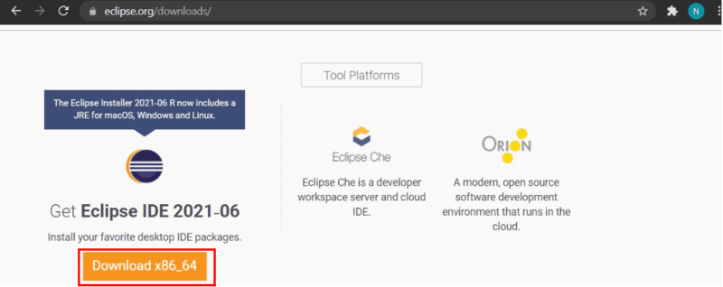
Step 3: Now, click on the “Download x86_64” button.

Slide 17
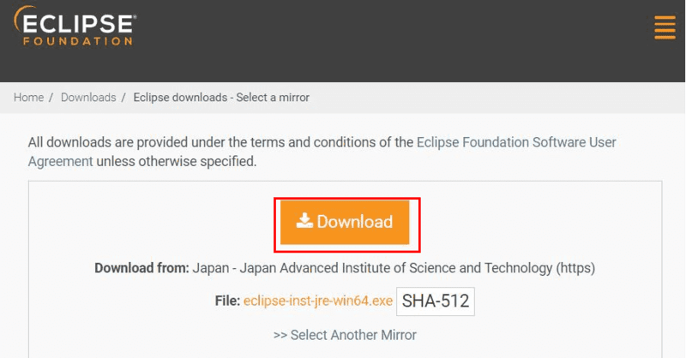
Step 4: Then click on the “Download” button. After clicking on the download button the .exe file for the eclipse will be downloaded.

Slide 18
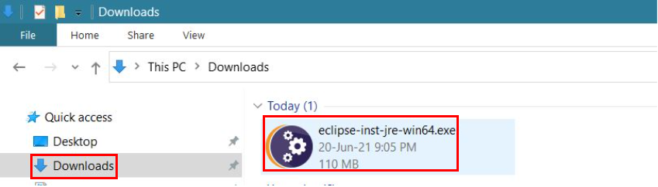
Step 5: Now go to File Explorer and click on “Downloads” after that click on the “eclipse-inst-jre-win64.exe” file for installing Eclipse IDE.

Slide 19
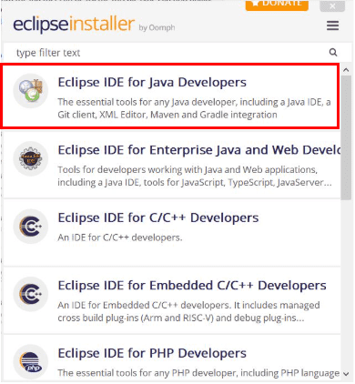
Step 6: Then, click on “Eclipse IDE for Java Developers”.

Slide 20
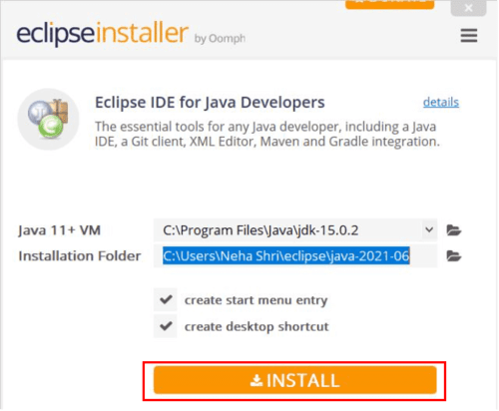
Step 7: Then, click on the “Install” button.

Slide 21
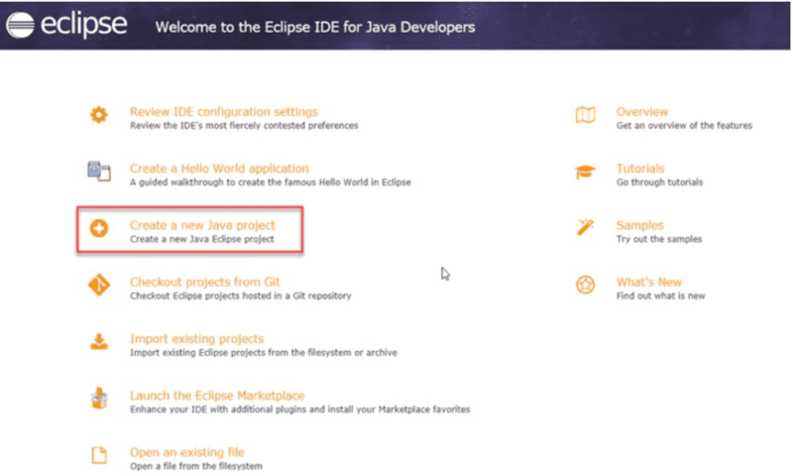
Step 8: Now click on “Create a new Java project”.

